Slide 1
DESIGN TECHNLOGIST
YT 147 subscribers

Slide 2
3 LEARNING GOALS
Creative Coding
Software/API Developer
Machine Learning & Data Science

Slide 3
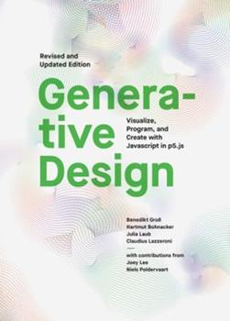
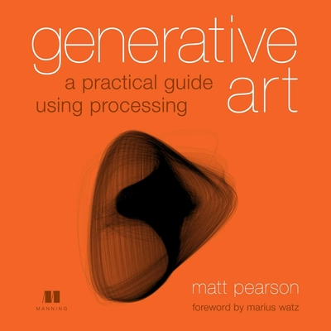
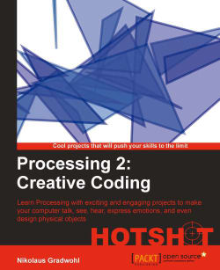
Creative CODING
Processing > Generative Design
P5.js, ml5.js, d3.js
Shaders, OpenGL, WebGL
Books:
Generative Art by Matt Pearson
Creative Coding Hotshot by Nikolaus Gradwohl
Github Processing Sketches Eg
https://github.com/manoloide/AllSketchs
(20/80) : Javascript

Slide 4
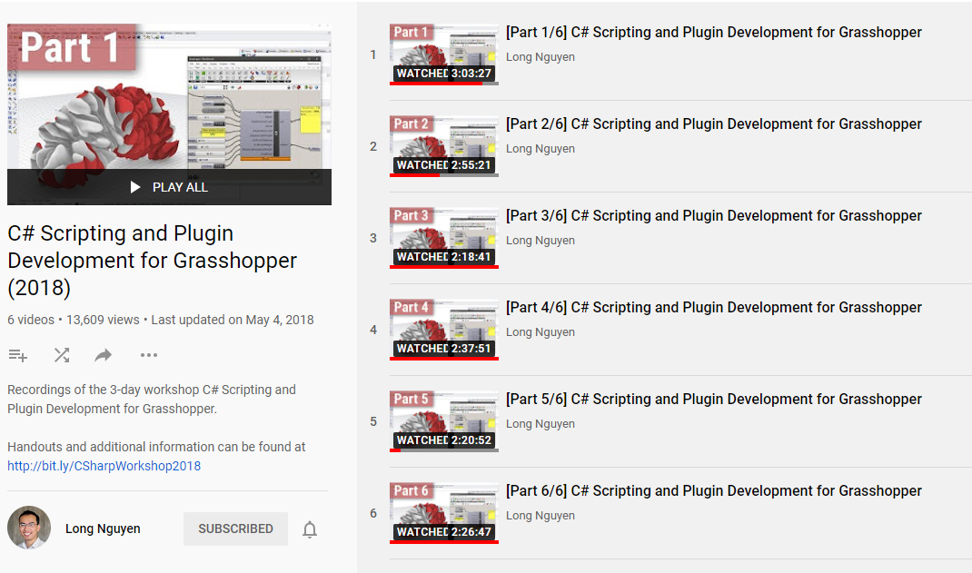
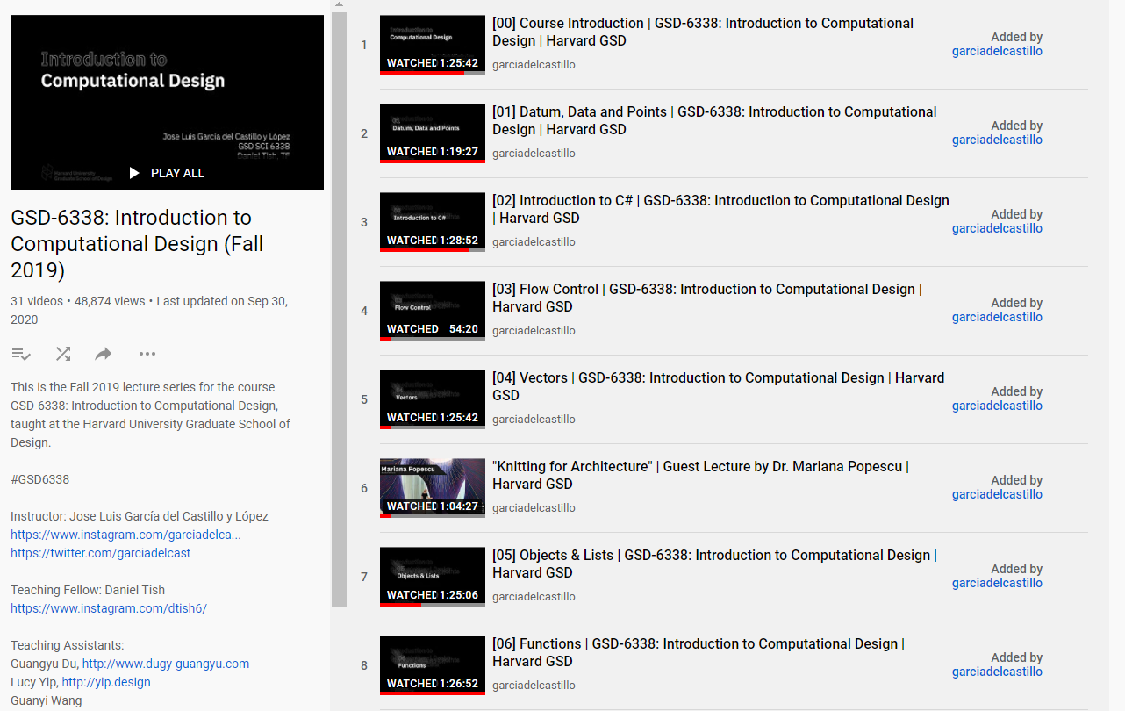
SOFTWARE/PLUGIN Developer
Resources:
https://www.icd.uni-stuttgart.de/teaching/workshops/workshop-live-streaming-c-scripting-and-plugin-development-for-grasshopper/
https://www.youtube.com/playlist?list=PLvxxYImPCApUXhX3te3IK32ileXHpzKY4
https://developer.rhino3d.com/api/RhinoCommon/html/R_Project_RhinoCommon.htm
https://wiki.mcneel.com/developer/home
Full Stack Developer (Linked Learning)
Node.js, Three.js, React API
(20/80) : C#, .NET Framework

Slide 5
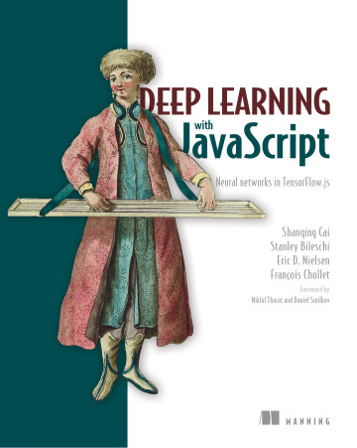
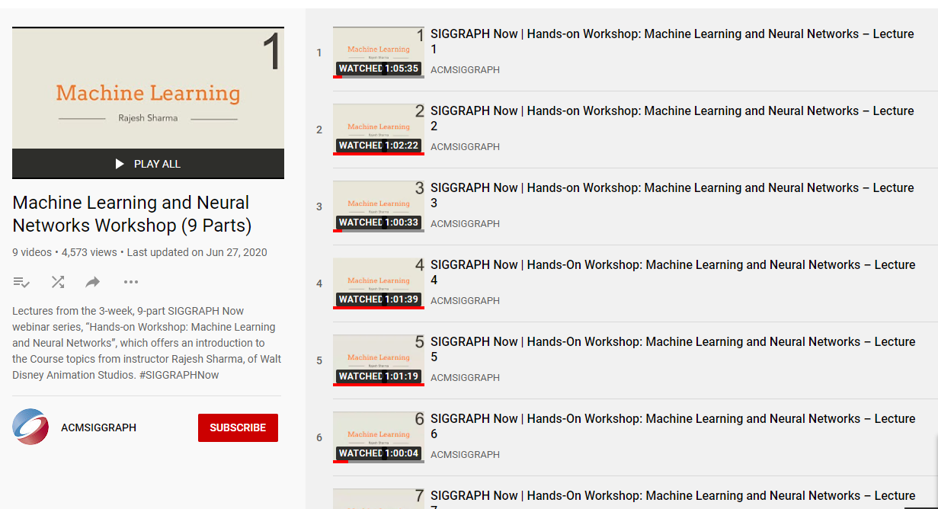
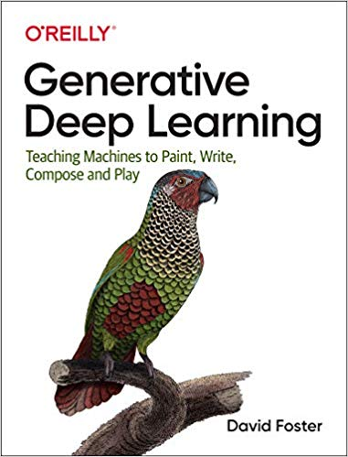
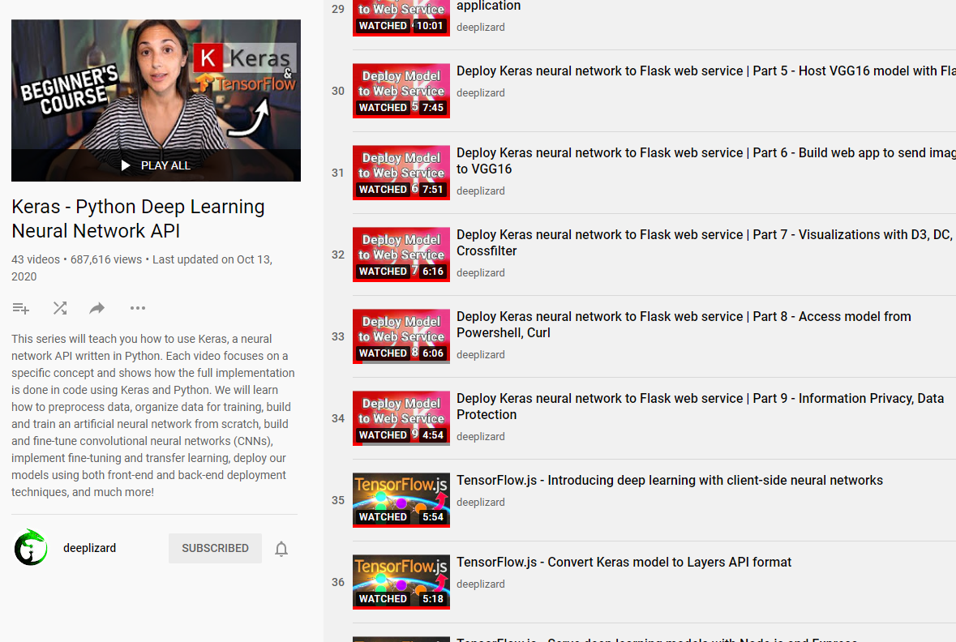
Machine Learning & DS
Books:
Deep Learning with JavaScript
ML Workshop : SIGGRAPH
https://www.youtube.com/playlist?list=PLUPhVMQuDB_b2kcOooEduedthcBH53mvC
Keras : Deeplizard
https://www.youtube.com/playlist?list=PLZbbT5o_s2xrwRnXk_yCPtnqqo4_u2YGL
(20/80) : GANs, Tensorflow.js

Slide 6
PEOPLE I WANT TO WORK WITH
Robert Otani | Thornton Tomasetti Core Studio
Stanislas Chaillou | Spacemaker AI
Ian Keough Andrew Heumann | Hypar
Nathan Miller | Proving Ground
Daniel Bolojan | Nonstandard Studio
Clifton Harness | Testfit.io
Nono Martinez Alonso | Autodesk

